Slide 1
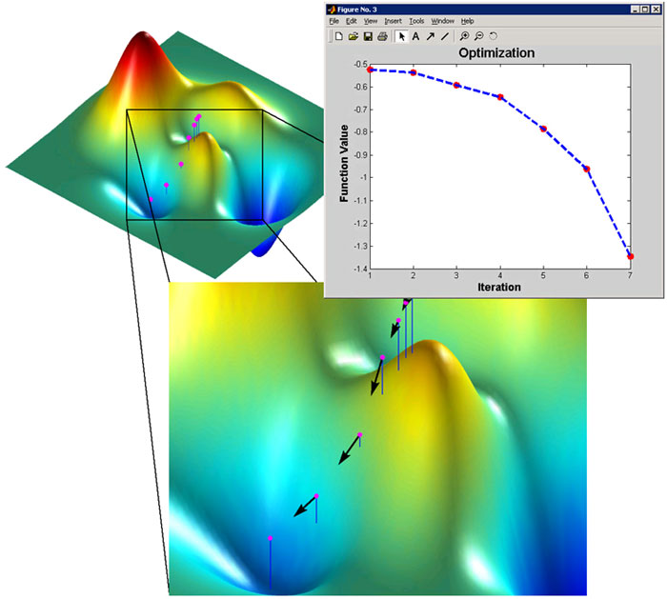
Optimization I

Slide 2
Overview of optimization problems
1-D unconstrained optimization
Golden section search
Newton’s method
n-D unconstrained optimization
Newton’s method
Steepest descent method

Slide 3
Optimization—in plain English
Given a single function f that depends on one or more independent variables
You want to find the value of those variables where f takes on a maximal or a minimal value

Slide 4
Optimization—in formal math
x* is called a minimum of f
It suffices to only consider minimization, since a maximum of f is a minimum of –f
Objective function f is usually differentiable, and may be linear or nonlinear
Constraint set S is defined by system of equations and inequalities, which may be linear or nonlinear
If S = R^{n}, the problem is unconstrained

Slide 5
Optimization Problems
General continuous optimization problem
Example: minimize the surface area of a cylinder subject to the constraint on its volume
x₁
x₂
V

Slide 6
Local vs Global Optimization
x* S is a global minimum if f(x*) ≤ f(x) for all x S
x* S is a local minimum if f(x*) ≤ f(x) for all feasible x in some neighborhood of x*
local minimum
global minimum

Slide 7
Unimodality
Real-valued function f is unimodal on interval [a, b] if there is unique x* in [a, b] such that
f(x*) is minimum of f on [a, b]
f is strictly increasing for x ≦ x*, strictly decreasing for x ≧ x*
Unimodality enables discarding portions of interval based on sampled function values, analogous to interval bisection

Slide 8
Critical Points
For function of one variable, one can find maxima /minima by finding the roots of f’(x)=0
Generalization to function of n variables is to find a critical point, i.e., solution of the nonlinear system
gradient vector of f

Slide 9
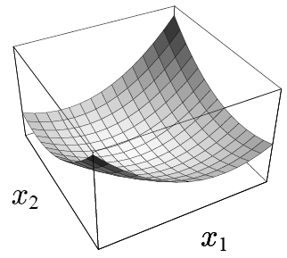
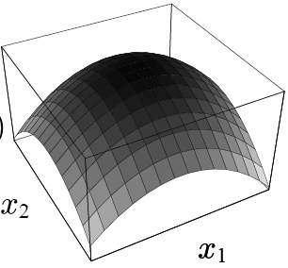
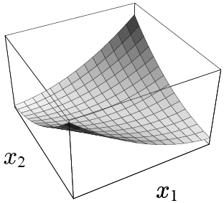
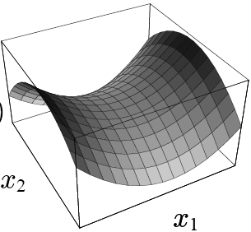
Critical Points (cont.)
For continuously differentiable f, any interior point x* of S at which f has a local minimum must be a critical point of f
But not all critical points are minima: they can also be maxima or saddle points

Slide 10
Hessian Matrix
For twice continuously differentiable f, we can distinguish among critical points by considering Hessian matrix defined by
which is symmetric

Slide 11




Hessian Matrix (cont.)
At critical point x*, if H_{f}(x*) is
Positive definite (x^{T}Hx > 0 for all vector x), then x* is a minimum of f
Negative definite, then x* is a maximum of f
Indefinite, then x* is a saddle point of f
Singular, then various pathological situations exist
positive definite
negative definite
indefinite
singular

Slide 12
Overview of optimization problems
1-D unconstrained optimization
Golden section search
Newton’s method
n-D unconstrained optimization
Newton’s method
Steepest descent method

Slide 13
Golden Section Search
If f is unimodal on [a, b]
Evaluating and comparing f(x₁) and f(x₂), we can discard either [a,x₁) or (x₂,b], with the minimum bracketed in the remaining subinterval
To repeat process, we need only compute one new function evaluation
a
x₁
x₂
b
r
a
b
a
x₁
x₂
b
1-r

Slide 14
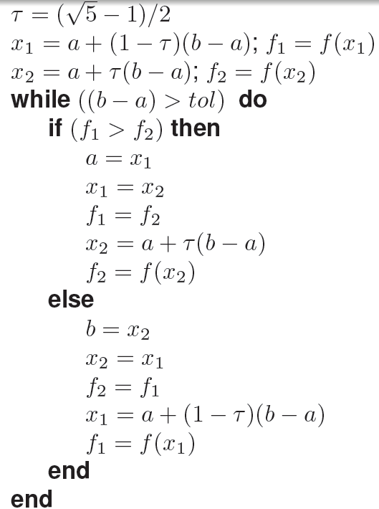
Golden Section Search (cont.)
a
x₁
x₂
b
r
a
b
a
x₁
x₂
b
1-r

Slide 15
Golden Section Search (cont.)
To reduce the interval length by fixed fraction at each iteration,
a
x₁
x₂
b
r
a’
x’₁
x’₂
b’

Slide 16
Newton’s Method for 1-D Minimization
Function can be locally approximated by a truncated series (a parabola)
The minimum of this quadratic function of h is given by

Slide 17
Newton’s Method for 1-D Minimization
Suggests iteration scheme
which is Newton’s method for solving nonlinear equation f’(x)=0
Newton’s method must be started close enough to the solution to converge since it is a local approximation

Slide 18
Example: 1-D unconstrained optimization
Golden section search http://www.cs.illinois.edu/~heath/iem/optimization/GoldenSection/
Newton’s method http://www.cs.illinois.edu/~heath/iem/optimization/Newton_Opt/

Slide 19
Overview of optimization problems
1-D unconstrained optimization
Golden section search
Newton’s method
n-D unconstrained optimization
Newton’s method
Steepest descent method

Slide 20
Newton’s Method for n-D Minimization
Generalization to multi-dimension
Recall that H need be positive definite to assure a global minimum
Drawbacks
Computation of Hessian is expensive
Hessian may not be available
Erratum on page 426 of the text!

Slide 21
Quasi-Newton Method
Quasi-Newton methods construct a new estimate of the Hessian matrix using information from previous iterates

Slide 22
Steepest Descent Method
Let f(x) be a real-valued function of n variables
Negative gradient, , points downhill toward lower values of f
Locally, f decreases more rapidly along the direction of negative gradient than any other
Steepest descent method: starting from initial guess x₀, successive approximate solutions given by
where α is the line search parameter determining how far to go in given direction

Slide 23
Interpreting Steepest Descent in Quadratic Form
The steepest descent method can be better understood by considering a quadratic objective function
Important definitions
error: e_{(k)} = x_{(k)} – x*
residual: r_{(k)} = b – Ax_{(k)} = -Ae_{(k)} = -▽f(x_{(k)})
assume A is symmetric
Think residual as the direction
of the steepest descent
x* is the minimum and Ax* = b

Slide 24
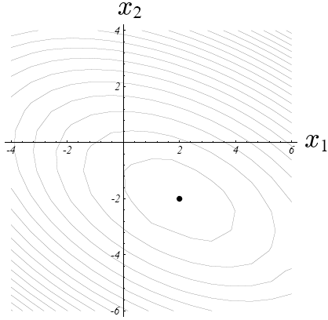
Line Search
How big of a step should we take?
Line search is a procedure that chooses α to minimize f along a line
x₍₁₎
x₍₀₎

Slide 25
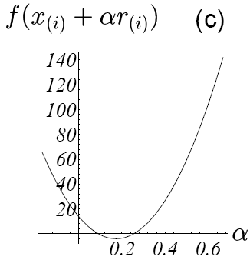
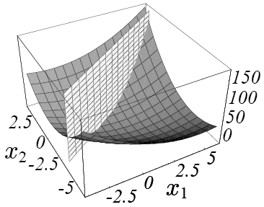
Line Search

Slide 26
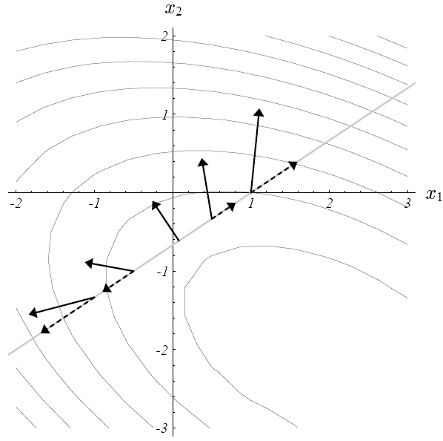
Optimize Step Size
Note that
Minimum occurs at where
f’(x₍₁₎) perpendicular to f’(x₍₀₎)

Slide 27
Optimize Step Size
Note that
Minimum occurs at where
perpendicular to

Slide 28
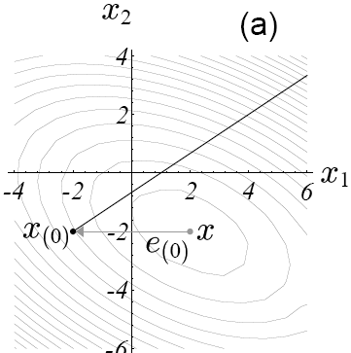

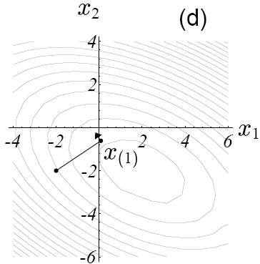

Steepest Descent Method

Slide 29

Geometric Interpretation
Projection of the gradient on the line is zero when it is orthogonal to
gradient projection = the slope of the curve

Slide 30
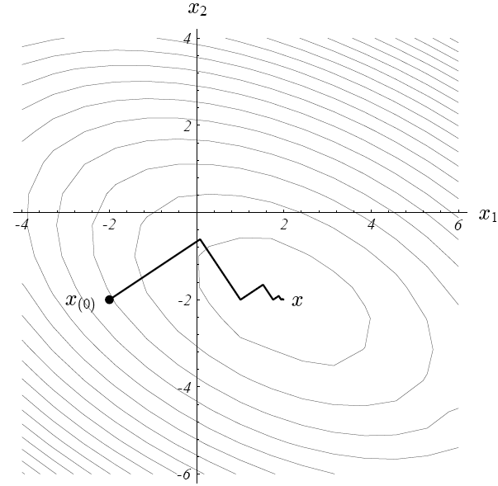
Steepest Descent Method
Read paper in http://www.cs.cmu.edu/~quake-papers/painless-conjugate-gradient-figs.pdf

Slide 31
Example: Steepest Descent Method
Minimize
Performing line search along negative gradient direction
exact minimum along line is given by α=1/3
http://www.cs.illinois.edu/~heath/iem/optimization/SteepestDescent/

Slide 32
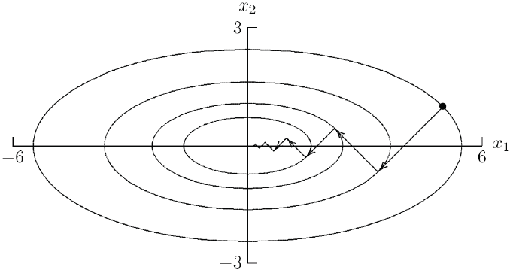
Steepest Descent Method
Reliable
Poor convergence
shortsighted in its view of function behavior
traversing at same directions
resulting zigzag iterations

